Slide 1
ADRA UKRAINE
Humanitarian Response
January, 2024

Slide 2
Facts of Ukraine
Population of Ukraine - 41 Mio people
The biggest country in Europe
(603К sq m, more than Lebanon in 60 times)
Zaporizka nuclear station (ZAES)
the biggest in Europe (3d in the world in terms of capacity)
In the 5 top exporters of grains in the world
(sunflower oil - 1st place, corn - 2nd)

Slide 3
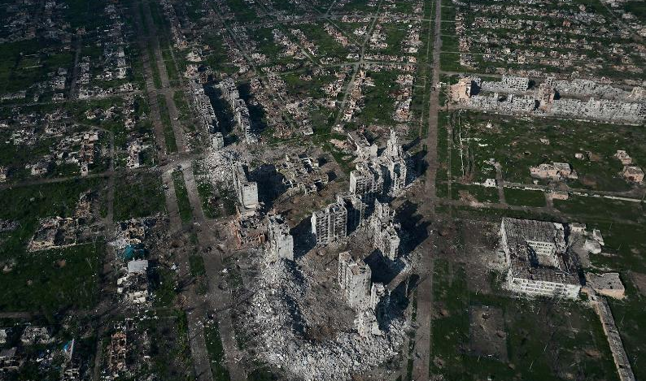

Result of the hostilities in the residential area
City of Bakhmut
2023

Slide 4
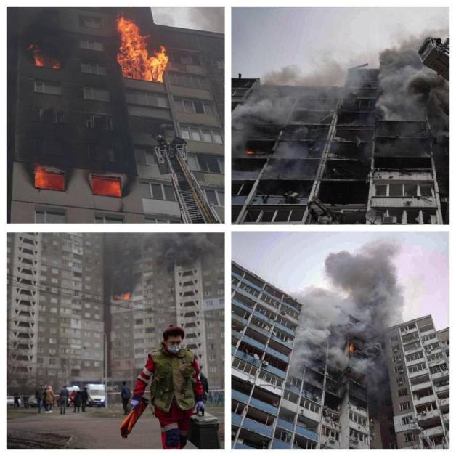
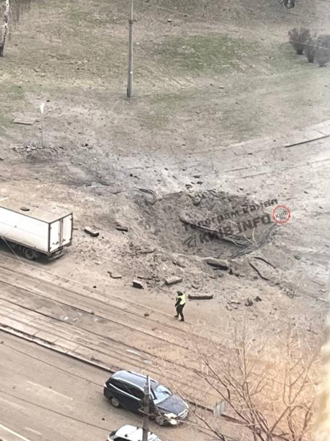
Missile attacks Kiev 07/02/24

Slide 5
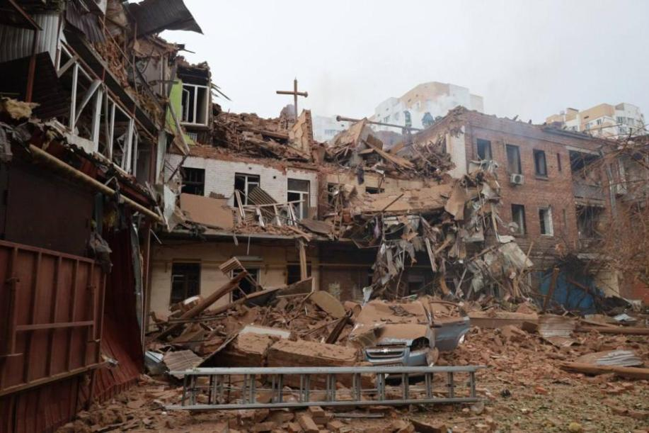
Missile attacks Kharkiv

Slide 6
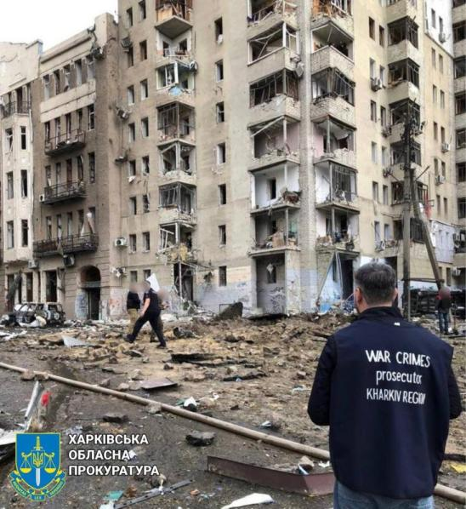
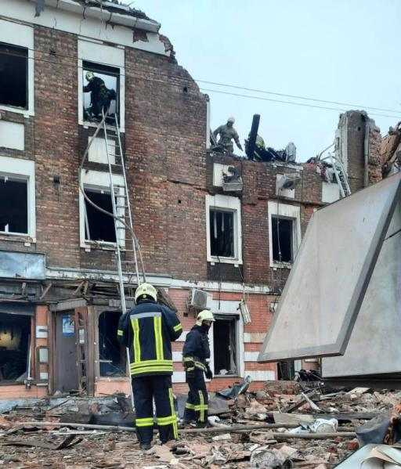
Missile attacks Kharkiv

Slide 7
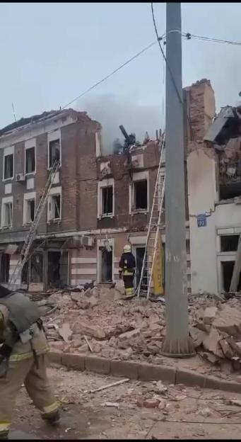
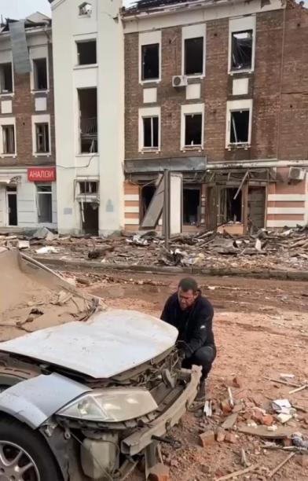
Missile attacks Kharkiv

Slide 8
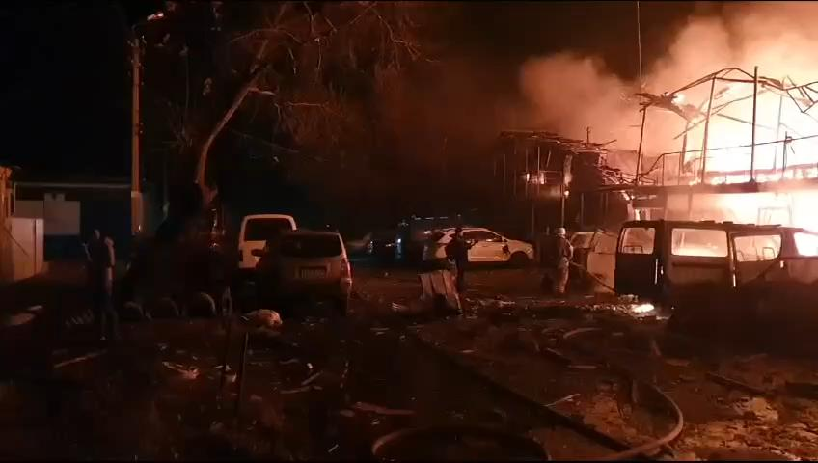
Missile attacks Kharkiv

Slide 9
Scale of the war in Ukraine
The biggest war conflict in the world since World war 2
The biggest front line of 1 500 km (in the world since World War 2)
16 000 firings on the Ukrainian territory (rocket, drones etc.): 97% - civil objects
32 189 air alarms
5 mln refugees
8 mln IDP’s
9 088 killed civilians (500 children), 15 000 injured (only government-controlled areas)
ZAES mined
Kakhovka Dam attack - ecocide (40 towns destroyed, 28 000 fish died)
148 000 sq km of occupied territory (approx. territory of Bangladesh)
263 000 killed soldiers only from one side
(in Afghanistan and Iraq for 20 years – 6 900; in Vietnam – 58 281)
34,000 total combat losses from one side (4 700 tanks, 315 airplanes, 316 helicopters)
40 000 sq km retaken (it’s more than some countries - Belgium 32 545 sq km)
Notes:
Масштаб войны в Украине
Крупнейший военный конфликт в мире со времен Второй мировой войны.
Самая большая линия фронта протяженностью 1 500 км (в мире со времен Второй мировой войны)
16 000 обстрелов на территории Украины (ракеты, дроны и т.д.): 97% - гражданские объекты
32 189 воздушных сигнализаций
5 миллионов беженцев
8 миллионов вынужденных переселенцев
9 088 убитых мирных жителей (500 детей), 15 000 раненых (только подконтрольные правительству территории)
ЗАЭС добыл
Атака Каховской плотины - экоцид (разрушено 40 городов, погибло 28 000 рыб)
148 000 кв.км оккупированной территории (ок. территория Бангладеш)
263 000 убитых солдат только с одной стороны (в Афганистане и Ираке за 20 лет – 6 900; во Вьетнаме – 58 281)
Общие боевые потери с одной стороны 34 000 (4 700 танков, 315 самолетов, 316 вертолетов)
Отвоевано 40 000 кв.км (больше, чем в некоторых странах - Бельгия 32 545 кв.км)

Slide 10
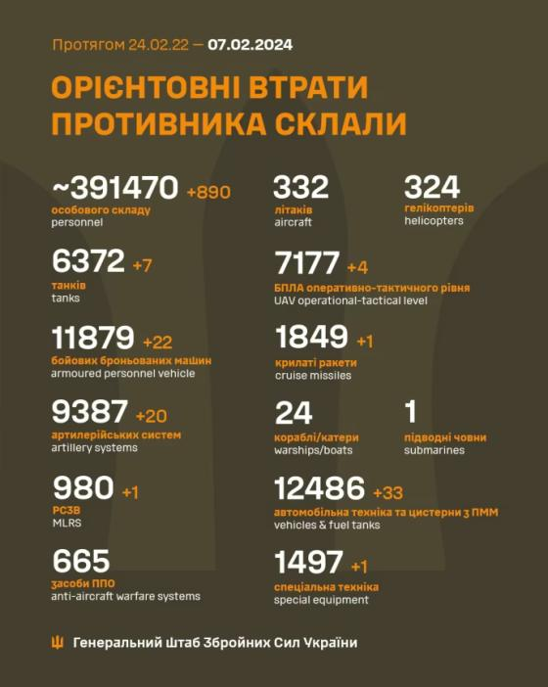
Scale of the war in Ukraine
Statistical information

Slide 11
ADRA UKRAINE
Emergency Response (2022 – 2023)

Slide 12
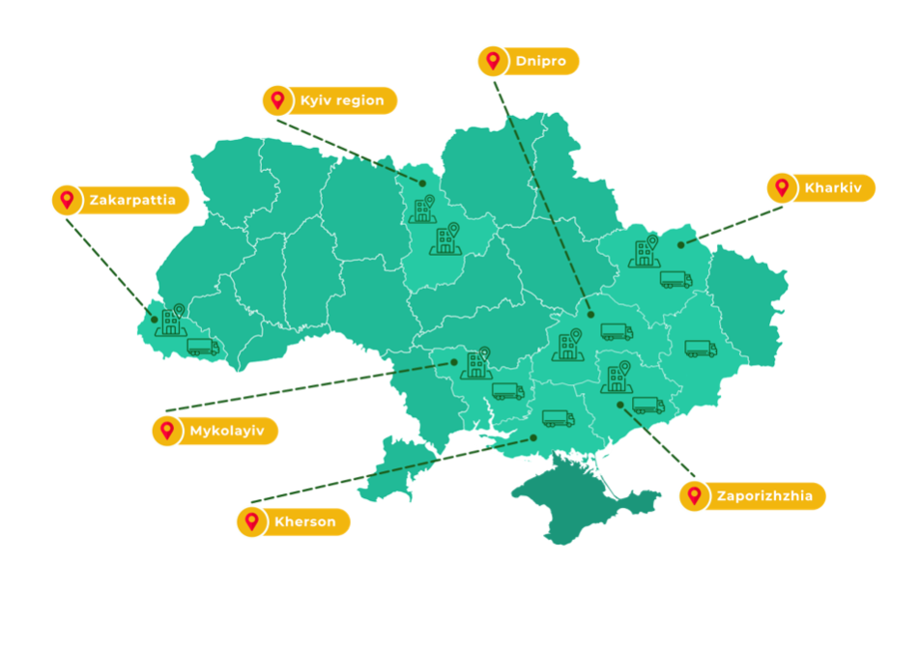


ADRA Offices & Warehouses
Offices
Warehouses
Notes:
ADRA Ukraine has 325 employees and ~300 volunteers.

Slide 13
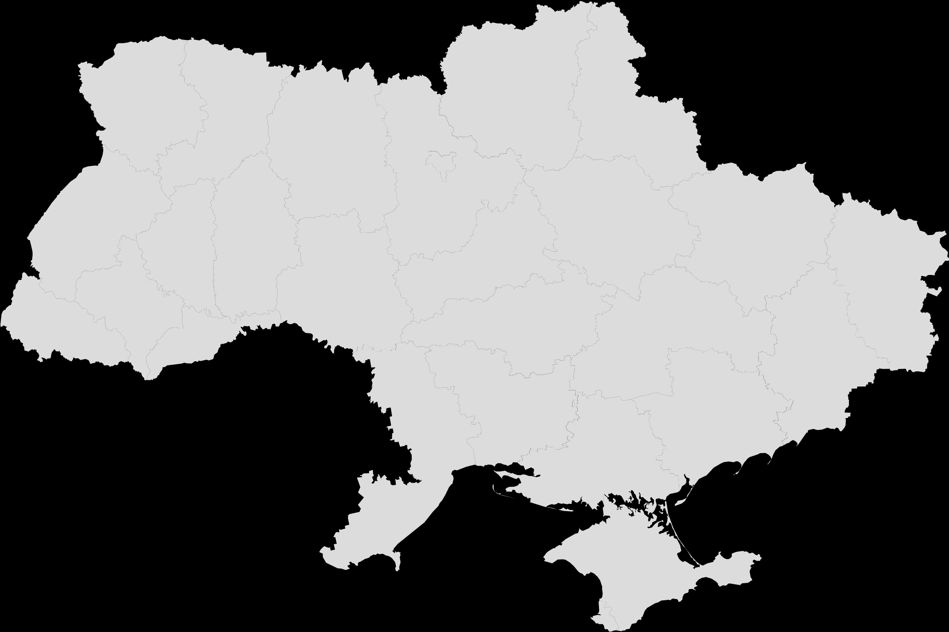








People reached with humanitarian assistance from 02.2022-01.2024 by sector
Target | Beneficiaries
Food Security | 2 161 036
Protection | 195 116
Cash | 161 124
Shelter | 15 057
Wash | 76 316
Health | 50 556
Total: | 2 659 205

Slide 14



Shelter
1 050 housings restorations (Light & Medium repairs) for 3 722 beneficiaries
629 construction materials vouchers were distributed in the amount of $674K
Solid fuel was distributed to 771 households and 3 big shelters
Heating systems were installed in 28 shelters

Slide 15
Shelter
The total number of beneficiaries by projects
Donor Name | Light & Medium repair, beneficiaries | Solid fuel, beneficiaries | NFIs, beneficiaries
ADRA Network EM22-071 | 1 634 | -
UHF | 1 904 | 822
GFFO | 184 | - | 5 038
SAMRS II (SlovakAid) | - | 25 | 45
EM23-077 Winterization | - | 532
ADRA Japan |  |  | 4 873
Total: | 3 722 | 1 379 | 9 956

Slide 16
Shelter

Slide 17
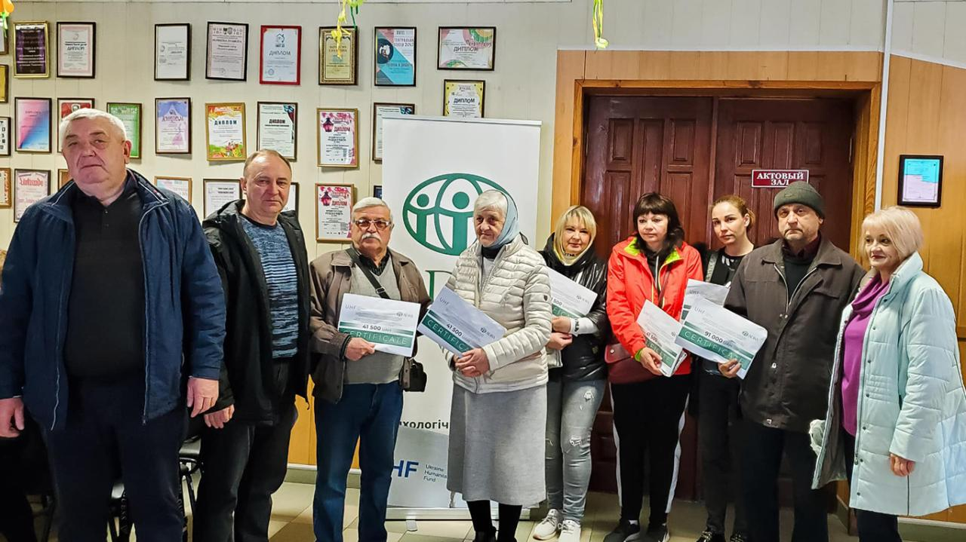
Shelter
Distribution of vouchers for house repairing

Slide 18
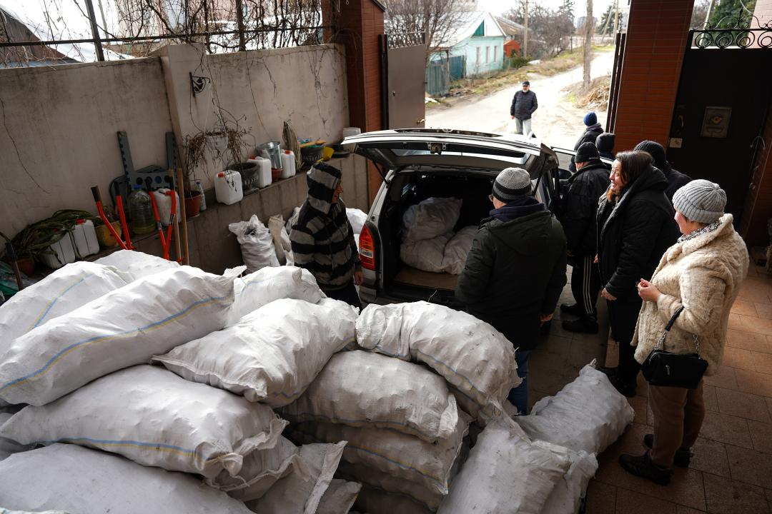
Shelter
Distribution of solid fuel

Slide 19
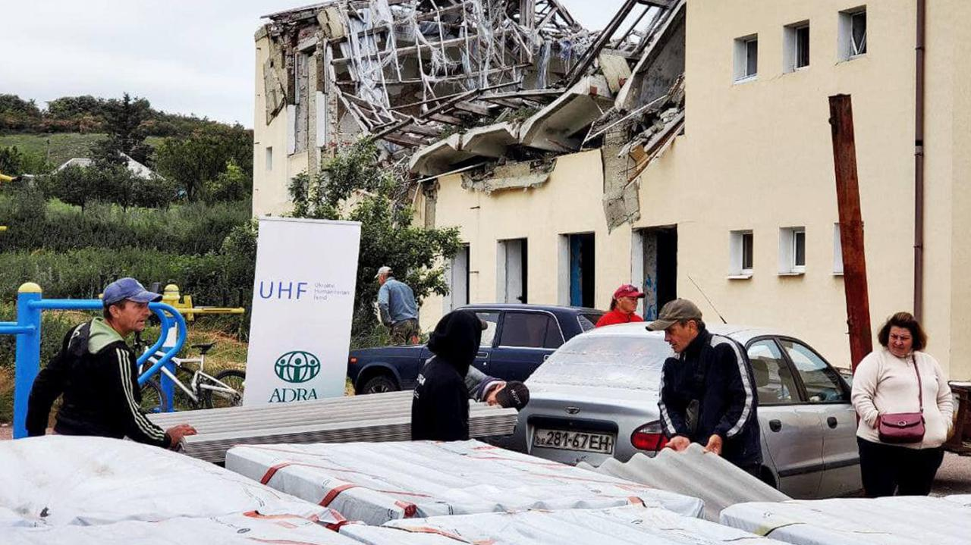
Shelter
Distribution of building materials

Slide 20

NFIs (non food assistance)
We are successfully distributed:
Winterization kits for 5 186 beneficiaries
Shoes & clothing for 4 770 beneficiaries
Generators in total amount of 170 pcs.

Slide 21
NFIs
The total number of total distributed generators amount
Donor Name | Amount of generators, pcs
Atlas Copco | 1
ADRA Japan | 4
ADRA Korea | 10
MoFa (JP) | 16
ADRA Poland | 19
ADRA Chezh | 22
SlovakAid | 18
UHF | 19
ADRA Germany | 61
Total: | 170

Slide 22
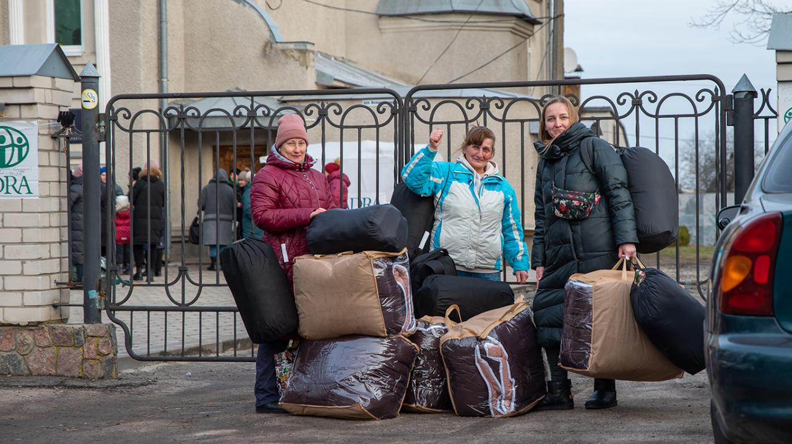
NFIs
Distribution of winterization kits

Slide 23
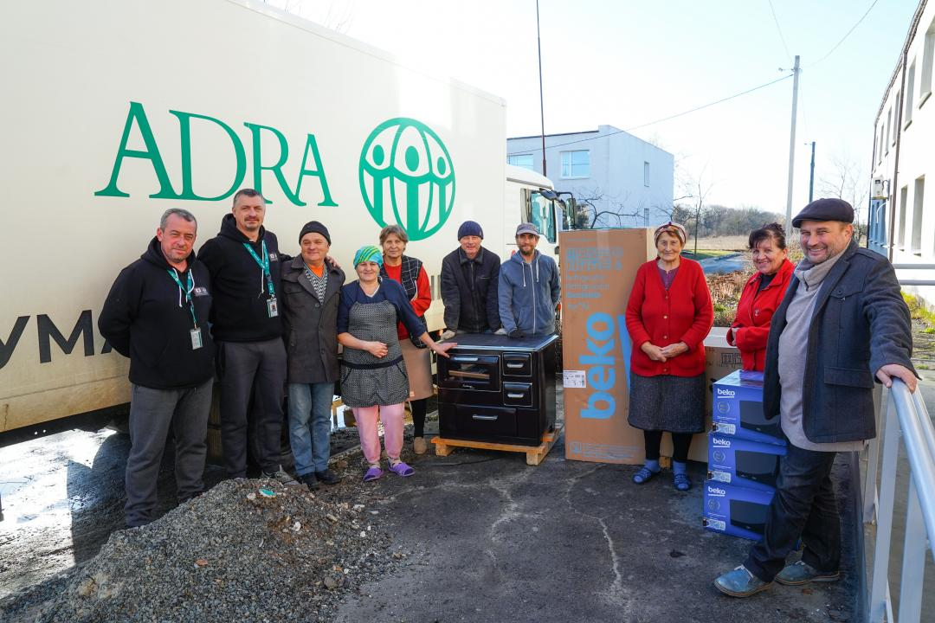
NFIs
Distribution of equipment

Slide 24
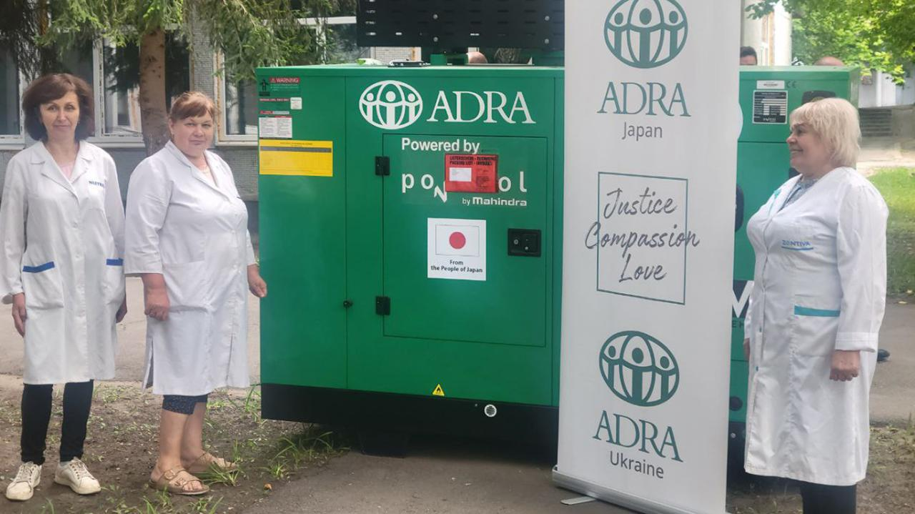
NFIs
Distribution of generators to medical institution

Slide 25


Protection
53 883 beneficiaries used ADRA social transport
41 896 beneficiaries were evacuated from front lines
70 396 beneficiaries are living in the shelters supported by ADRA

Slide 26
Protection
The total number of beneficiaries by projects
Donor Name | Evacuation, beneficiaries | Transportation, beneficiaries | Shelter, beneficiaries | PSS, beneficiaries | Legal service, beneficiaries
ADRA Czech | 8 030 | - | 33 | - | -
ADRA Korea | 679 | - | - | - | -
LDS & ADRA Network | - | - | 511 | 250 | -
Network EM22-015 | 2 891 | - | 10 456 | - | -
Network EM22-027 | - | - | 55 121 | - | -
GFFO | 2 408 | 29 421 | 1 945 | 8 588 | 793
IHA | 22 164 | - | 1 791 | 13 272 | -
Network EM22-071 | - | - | 487 | - | -
UHF | 5 724 | 24 462 | - | - | -
Danida | - | - | 52 | 6 038 | -
Total: | 41 896 | 53 883 | 70 396 | 28 148 | 793

Slide 27
Protection

Slide 28
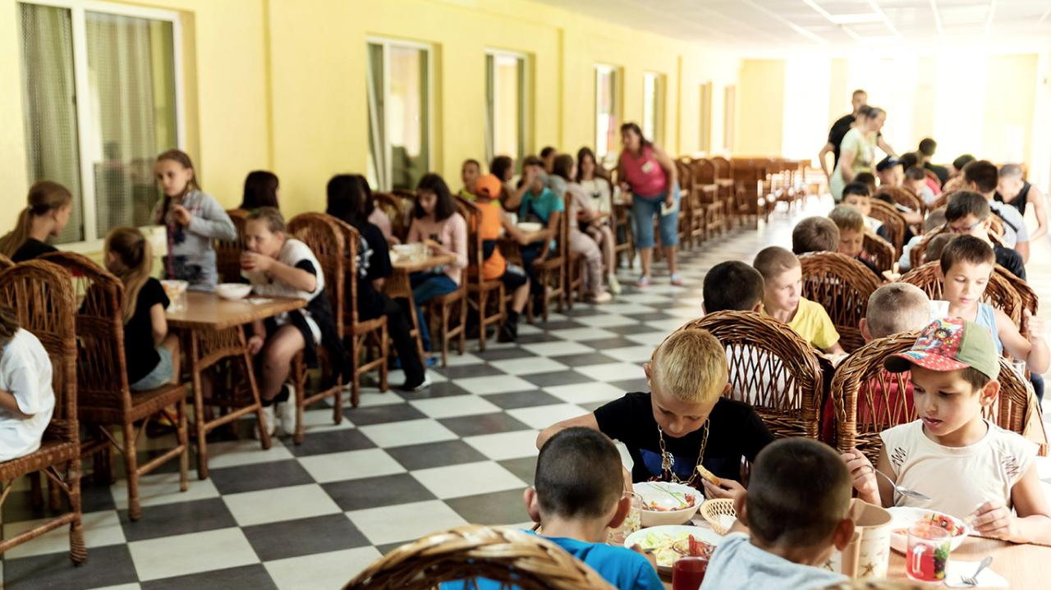
Protection
Children having lunch in a protection center

Slide 29
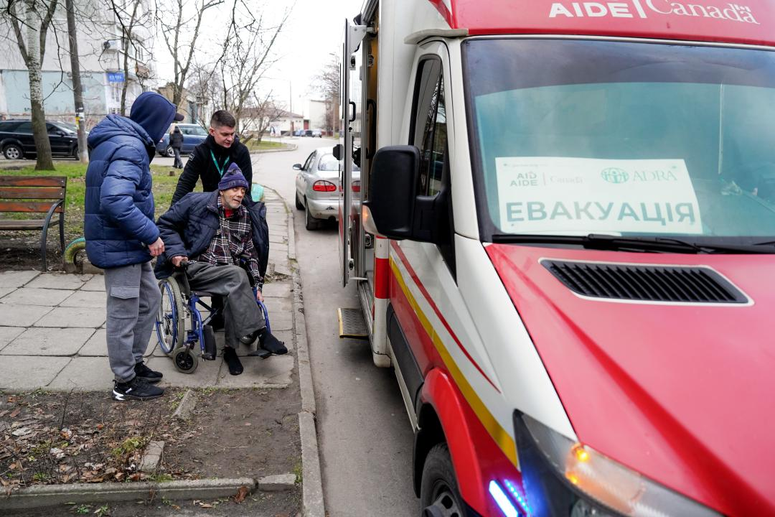
Protection
Evacuation of immobile people

Slide 30
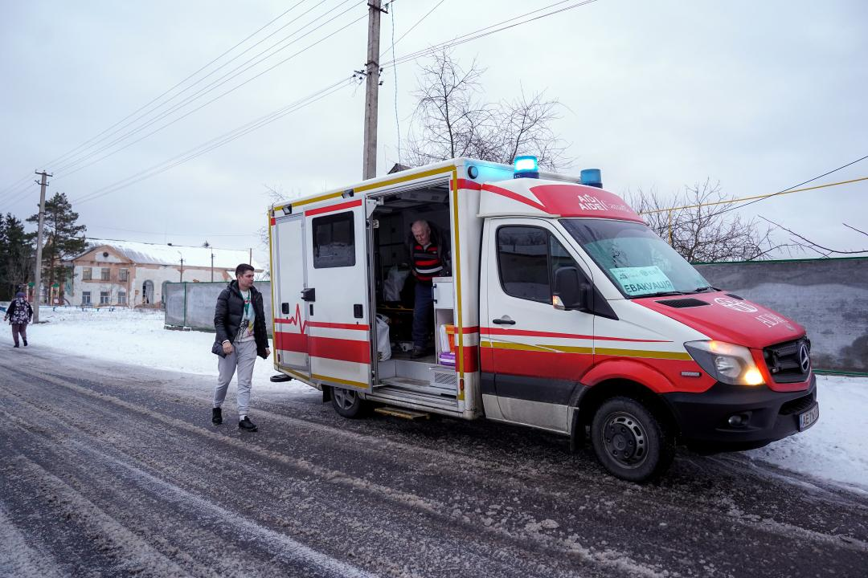
Protection
Evacuation

Slide 31
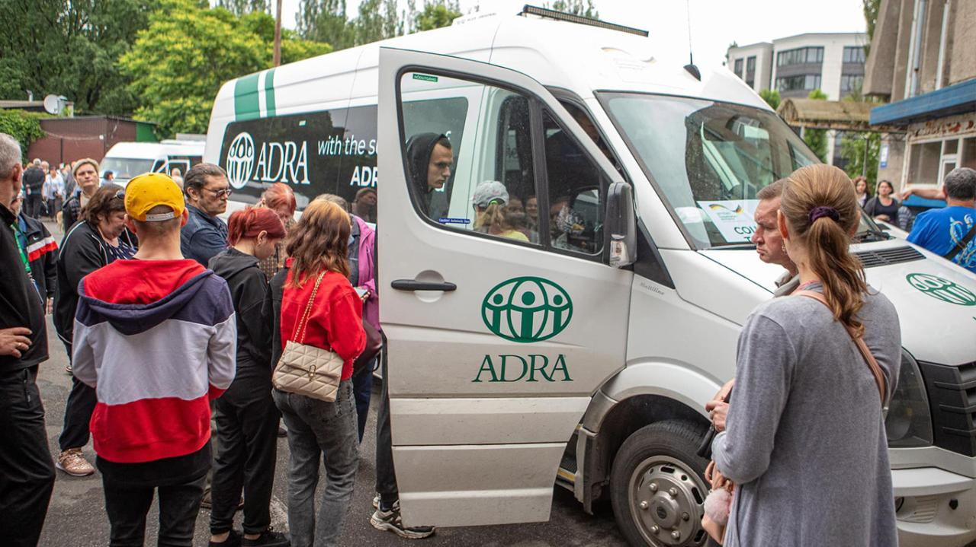
Protection
Social transportation

Slide 32

Protection
Legal assistance for IDPs

Slide 33

PSS (psychosocial support)
28 148 people
have received the psychosocial support
from 24 Psychologists, including 3 Psychotherapists

Slide 34
PSS
The total number of beneficiaries by projects
Donor Name | Number of beneficiaries
LDS and ADRA Network | 250
DANIDA | 6 038
GFFO | 8 588
IHA | 13 272
Total: | 28 148

Slide 35

PSS
Assistance for children with disabilities

Slide 36
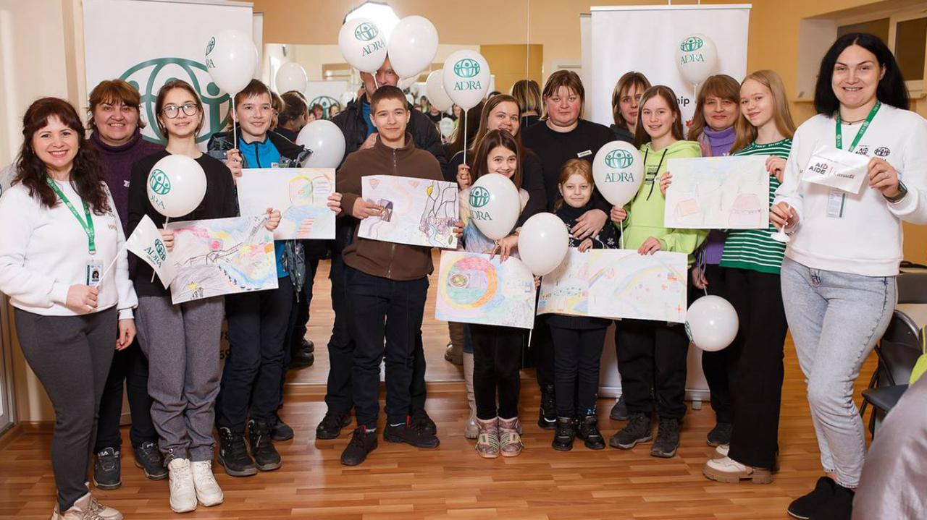
PSS
Assistance for internally displaced children

Slide 37

MPCA (cash assistance)
83 289 people
Cash statistics (number of beneficiaries)
have received cash assistance (MPCA) in total of $15 Mio

Slide 38
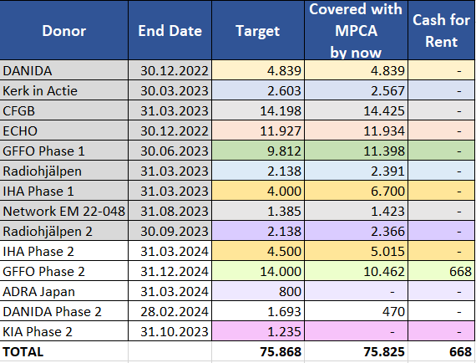
Cash statistics (number of beneficiaries)
Donor Name | Covered with MPCA, beneficiaries | Cash for Rent, beneficiaries | Microgrants, beneficiaries
Network EM 22-016 | 1 835 | - | -
Network EM 22-022 | - | - | 11 409
Minigrants for the church in Ukraine (ADRA CZ) | - | - | 65 486
DANIDA | 6 769 | - | -
KIA | 3 845 | - | -
CFGB | 14 425 | - | -
ECHO | 11 934 | - | -
GFFO | 25 081 | 940 | -
RadioAid | 4 757 | - | -
LEAP IHA | 12 700 | - | -
Network EM 22-048 | 1 423 | - | -
ADRA Japan | 520 | - | -
Total: | 83 289 | 940 | 76 895

Slide 39
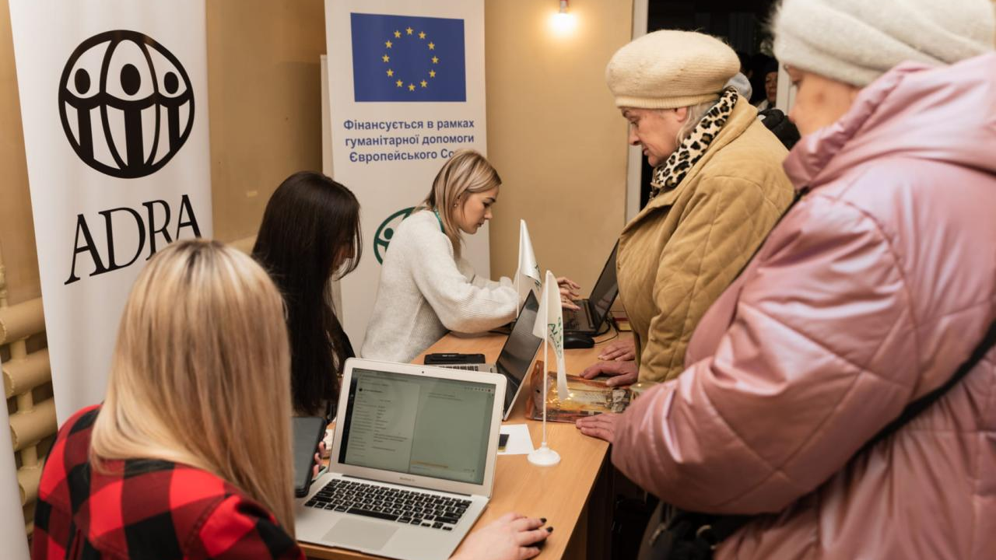
Cash
Offline cash assistance registration

Slide 40
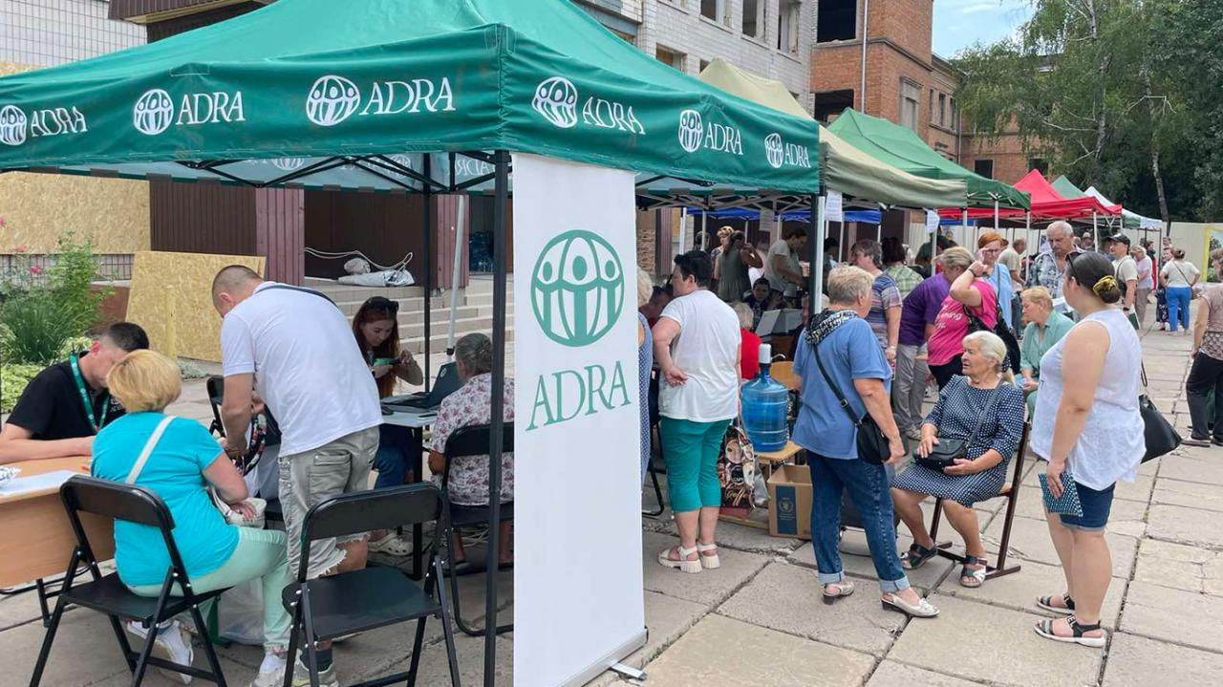
Cash
MPCA registration after the missile attack

Slide 41
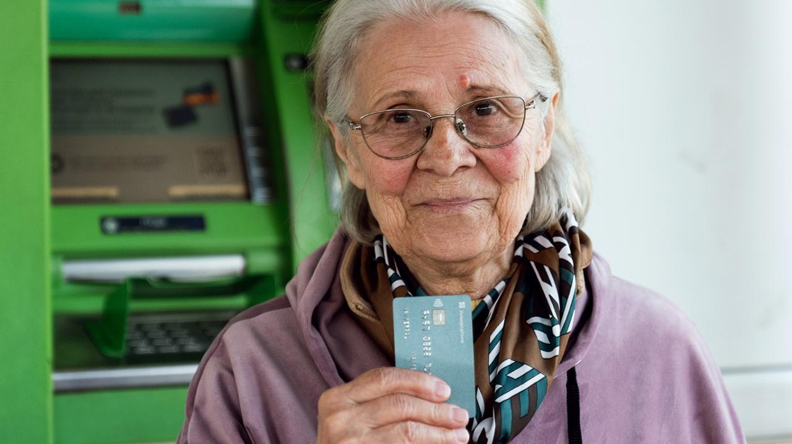
Cash
ADRA Ukraine beneficiary who has received the MPCA

Slide 42



Food Security
We are successfully distributed:
Food kits: 166 046 tons
Food vouchers: 221 227 pcs

Slide 43
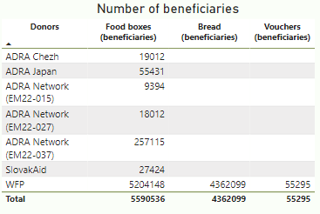
Food Security
The total number of beneficiaries
Donor Name | Food boxes, beneficiaries | Bread, beneficiaries | Vouchers, beneficiaries
ADRA Chezh | 19 012 | - | -
ADRA Japan | 58 467 | - | -
Network EM 22-015 | 9 394 | - | -
Network EM 22-027 | 18 012 | - | -
Network EM 22-037 | 283 669 | - | -
SlovakAid | 40 708 | - | -
WFP + ADRA Switzerland | 1 102 973 | 480 998 | 147 803
Total: | 1 532 235 | 480 998 | 147 803

Slide 44
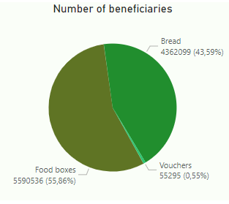
Food Security

Slide 45
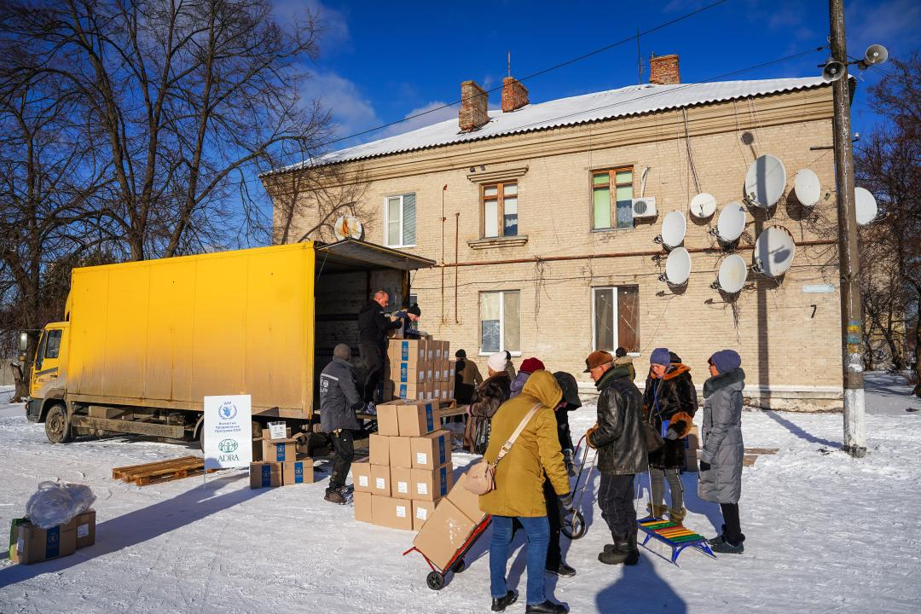
Food Security
Distribution of food kits

Slide 46
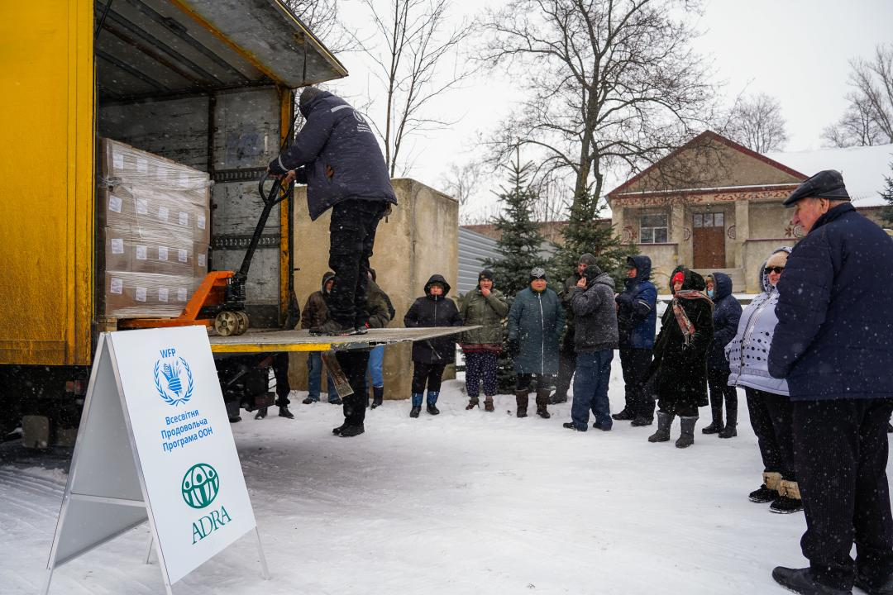
Food Security
Distribution of food kits

Slide 47
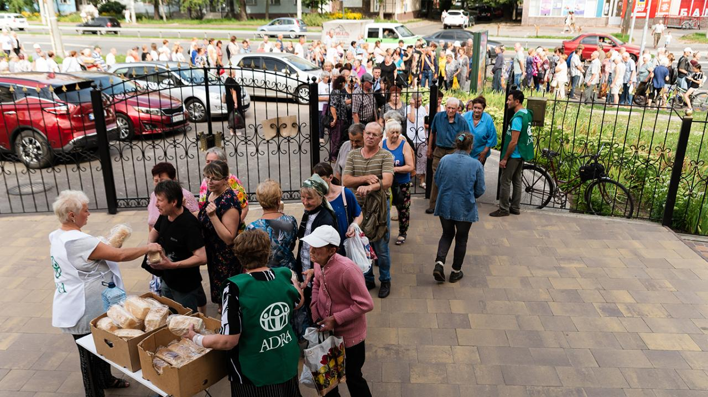
Food Security
Distribution of bread loaves

Slide 48


WASH (water, sanitation and hygiene)
99 715 of bottled water was delivered
35 532 people have received hygiene kits
6 of wells were drilled
11 of water purification systems were installed
40 784 people have received access to drinking water

Slide 49
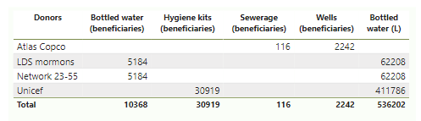
WASH
The total number of beneficiaries
Donor Name | Bottled water, beneficiaries | Hygiene kits, beneficiaries | Access to water (wells), beneficiaries | Access to water (purification stations), beneficiaries
Atlas Copco | - | - | 2 242 | 318
LDS | 3 939 | - | - | 4 953
Network EM23-055 | 6 208 | 2 333 | - | 4 062
UNICEF | 10 862 | 33 199 | - | -
Flood Response (CZ) | 1 700 | - | 3 500 | 3 000
Total: | 22 709 | 35 532 | 5 742 | 12 333

Slide 50
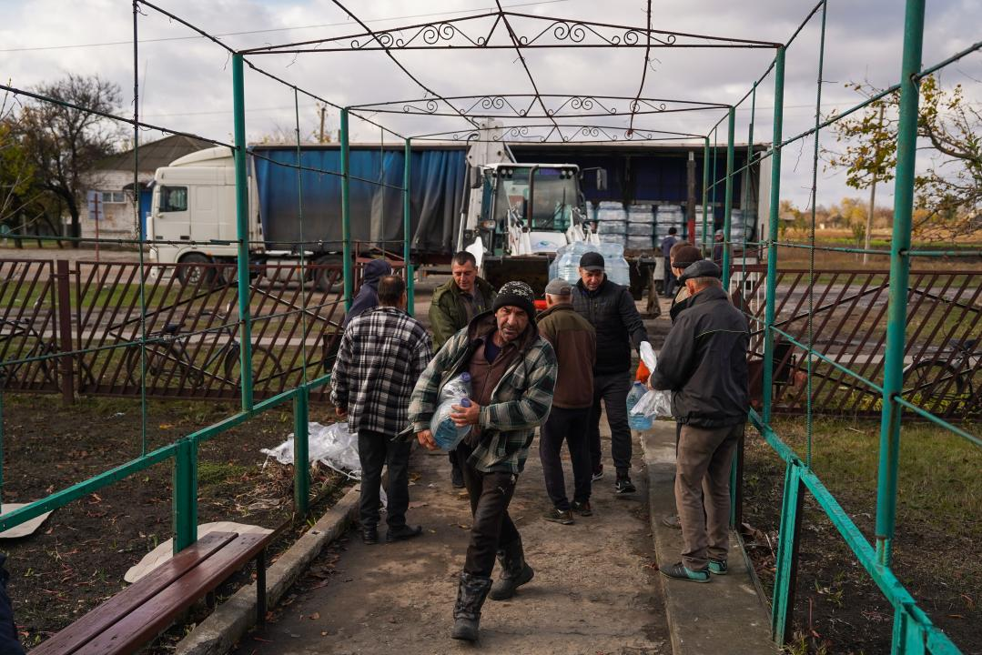
WASH
Distribution of bottled water

Slide 51
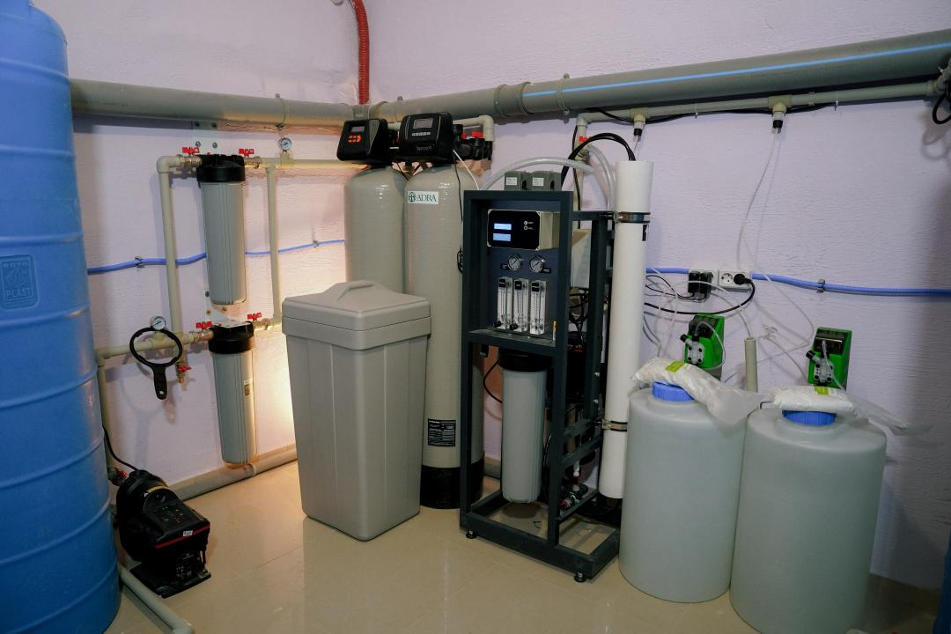
WASH
water purification system

Slide 52
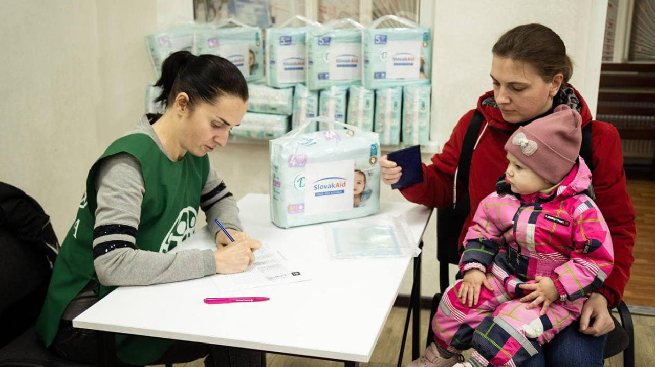
WASH
Distribution of hygiene kits

Slide 53
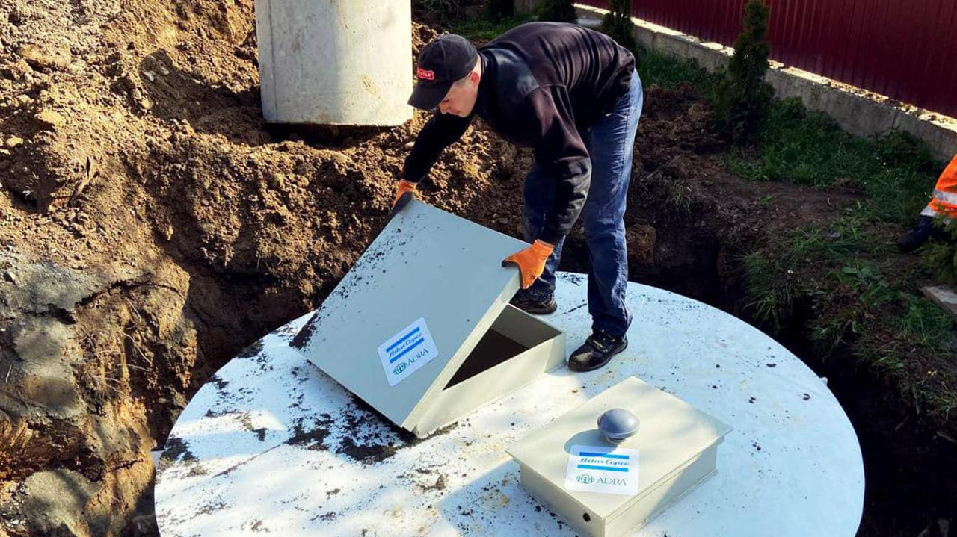
WASH
Intallation of a sewer system

Slide 54

Health
We are successfully distributed to the hospitals:
3 trucks of medical supplies
39 medical equipment
16 generators (50 to 160 kW)
336 wheelchairs for beneficiaries

Slide 55
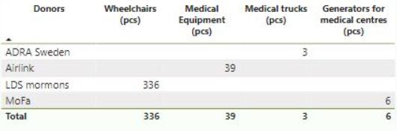
Health
The total number of distributed pieces
Donor Name | Wheelchairs, pcs | Medical Equipment, pcs | Medical supplies, pcs | Generators for medical centers, pcs
ADRA Sweden OneMed | - | - | 3 | -
Airlink & Tzu Chi | - | 39 | - | -
LDS | 336 | - | - | -
MoFa (JP) | - | - | - | 16
Total: | 336 | 39 | 3 | 16

Slide 56
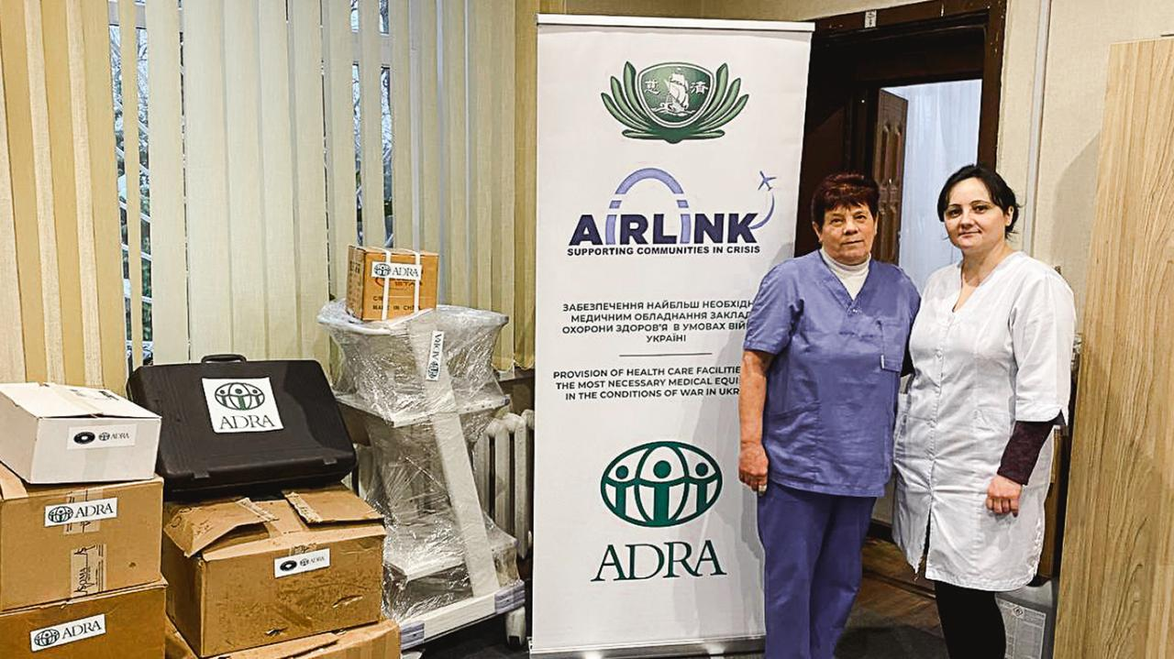
Health
Distribution of medical equipment

Slide 57
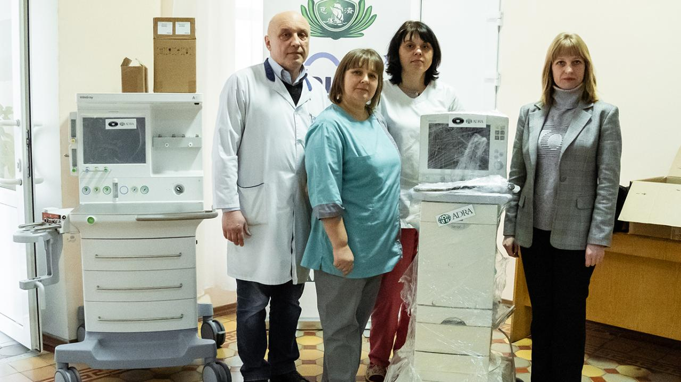
Health
Distribution of medical devices

Slide 58
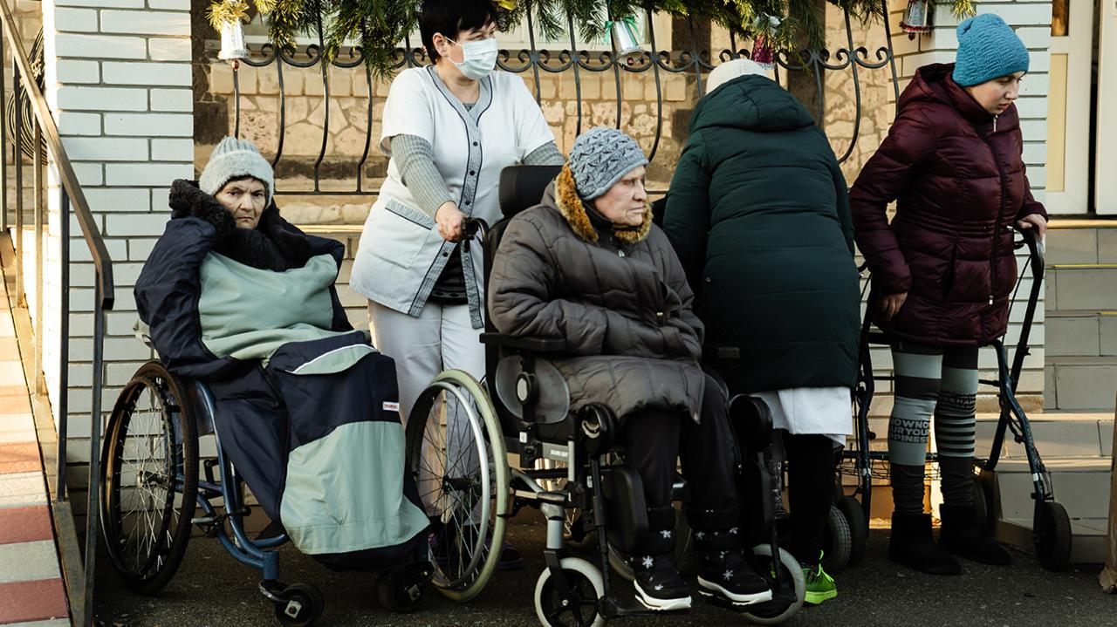
Health
Distribution of wheelchairs

Slide 59
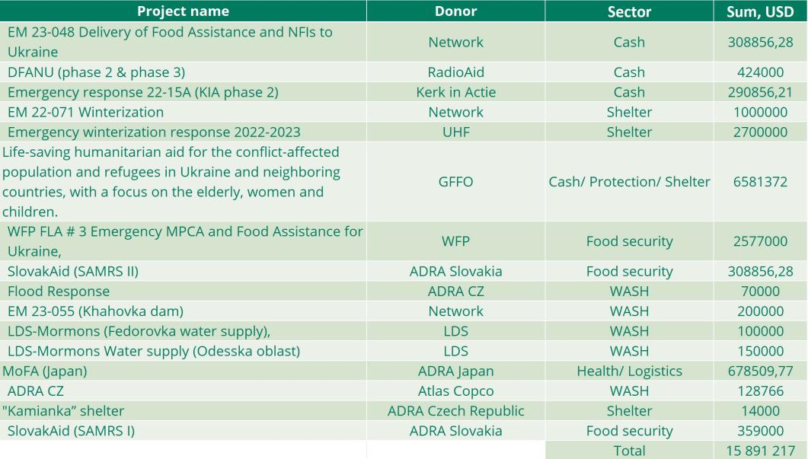

16 projects were successfully completed in 2023 year

Slide 60
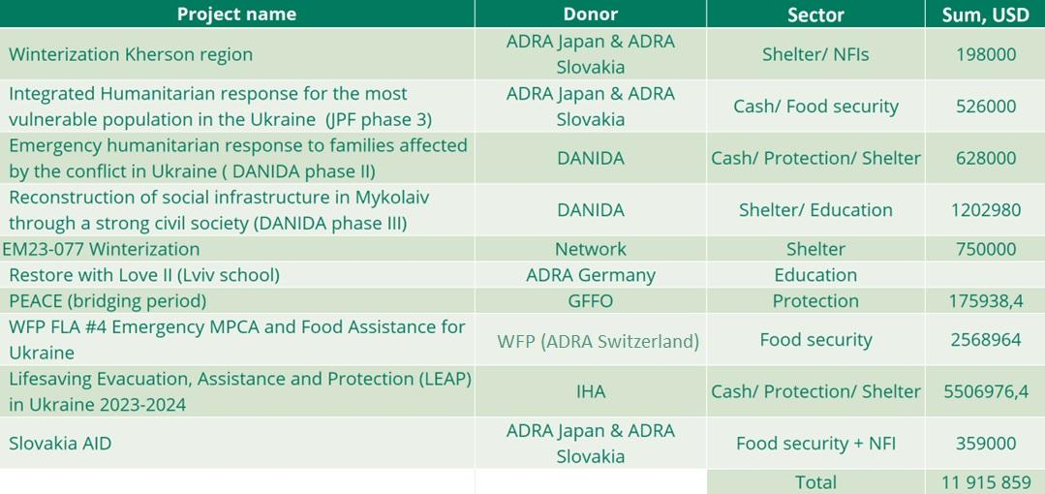
Projects currently being implemented

Slide 61

Coordination and Partnership
ADRA Ukraine is represented in the following clusters:
Cash working group
Health
Protection
Logistics
Shelter
Education
WASH
Food Security
& Livelihoods

Slide 62
Coordination and Partnership
ADRA Ukraine maintains liaison with:
UN agencies
Local NGOs
Hope Media Group
ASD Church Network
Local & National Governments
InterAction Ukraine Working Group

Slide 63
List of Partners and Donors
ADRA Austalia
ADRA Austria
ADRA Brazil
ADRA Bulgaria
ADRA Canada
ADRA China
ADRA Croatia
ADRA Czech Republic
ADRA Denmark
ADRA Fidji
ADRA Finland
ADRA France
ADRA Germany
ADRA Great Britain
ADRA Italy
ADRA Japan
ADRA Korea
ADRA Netherlands
ADRA New Zealand
ADRA Norway
ADRA Peru
ADRA Philippines
ADRA Poland
ADRA Portugal
ADRA Romania
ADRA Slovakia
ADRA Spain
ADRA Sweden
ADRA Switzerland
ADRA Taiwan
Aktion Deutschland Hilft
Atlas Copco
CFGB
DANIDA
ECHO
FNPC
GFFO
Hope for Ukraine
IHA
Japan Platform
KOA
LDS
MOFA (JP)
Nadacia
OneMed
Radiohjalpen
SlovakAid
UHF
UNHCR
UNICEF
OCHA
USAID
WFP
Humedica
KOA

Slide 64

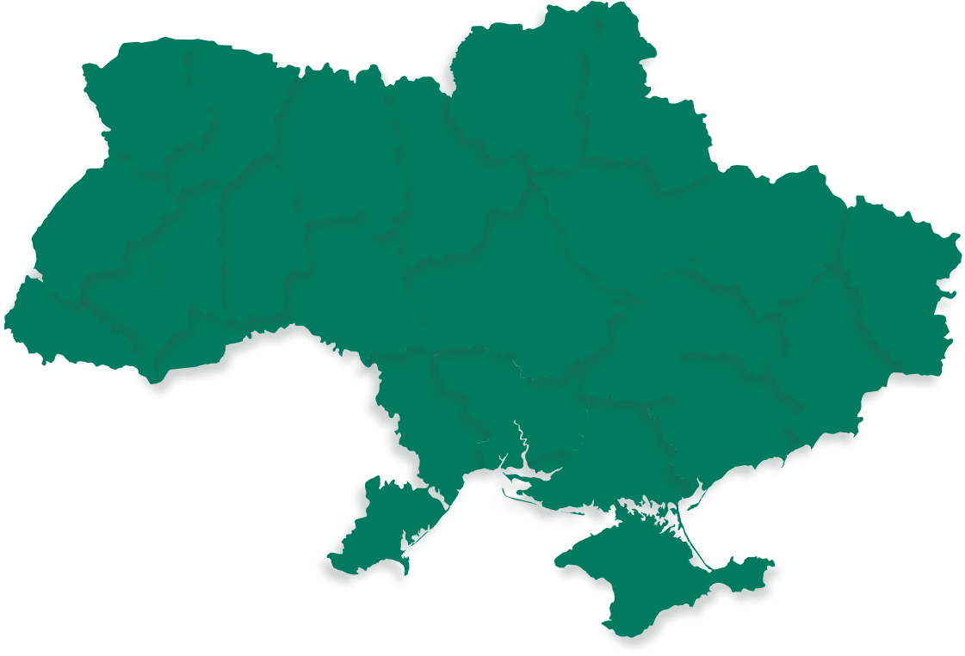

Thank you for supporting Ukraine!

