Slide 1
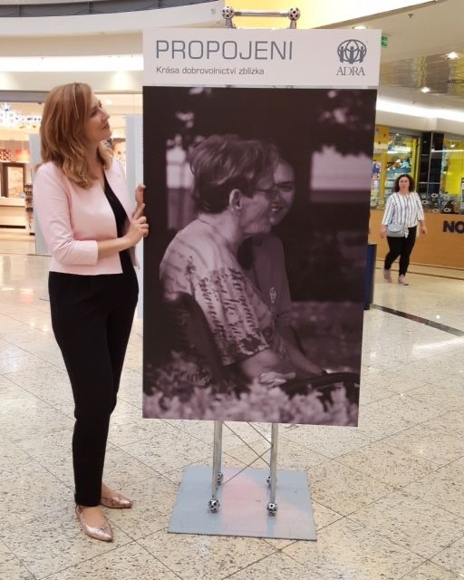
Company fundraising
My beloved job
Renáta Benešová Chlebková
ADRA Czech Republic

Slide 2
What is ahead of us?
why companies are important for cooperation?
do we need a dream list of companies?
first connection
first meeting
taking care of companies
opportunities
vision

Slide 3
What does fundraising
mean to you?

Slide 4
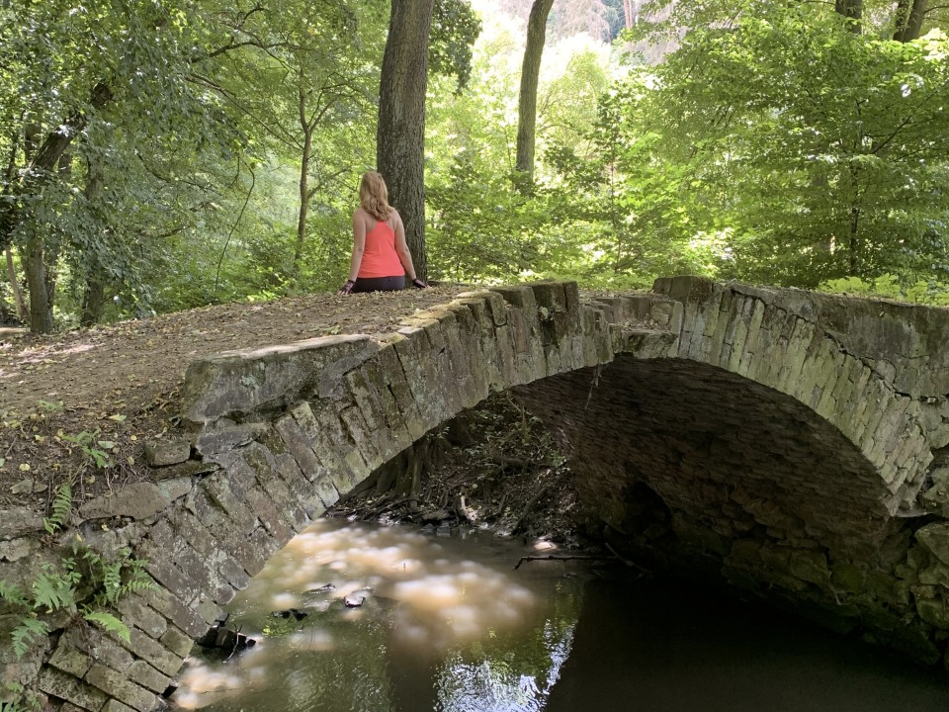

Slide 5
What does fundraising
mean to you?

Slide 6
Do we need these abreviations?
CSR
SDG
ESG

Slide 8
Which company in your country was famous for its support of society?

Slide 9
Which company in your country is now the most inspirational for you?

Slide 10
What is ahead of us?
why companies are important for cooperation?
do we need a dream list of companies?
first connection
first meeting
taking care of companies
opportunities
vision

Slide 11
Why are companies important
for cooperation?
They need us.
We need them.
A lot of possibilities of donation.

Slide 12
What is ahead of us?
why companies are important for cooperation?
do we need a dream list of companies?
first connection
first meeting
taking care of companies
opportunities
vision

Slide 13
Do we need a dream list
of companies?
donors list
contacts list
my dream contacts

Slide 14
Which company is the most important for you?
…and why?

Slide 15
Your dream company?

Slide 16
What is ahead of us?
why companies are important for cooperation?
do we need a dream list of companies?
first connection
first meeting
taking care of companies
opportunities
vision

Slide 17
How to connect with a new company?
email
phone call
LinkedIn message
events
anything else…

Slide 18
Homework for evening :)
Connect with three people via LinkedIn - donors / contacts / friends /
people from dream company

Slide 19
What is ahead of us?
why companies are important for cooperation?
do we need a dream list of companies?
first connection
first meeting
taking care of companies
opportunities
vision

Slide 20
First meeting
Online / Face to face
I listen more than I talk
I offer more than I ask for
NO, it does not mean NO forever
Stay in touch
Touch their heart

Slide 21
What is ahead of us?
why companies are important for cooperation?
do we need a dream list of companies?
first connection
first meeting
taking care of companies
opportunities
vision

Slide 22
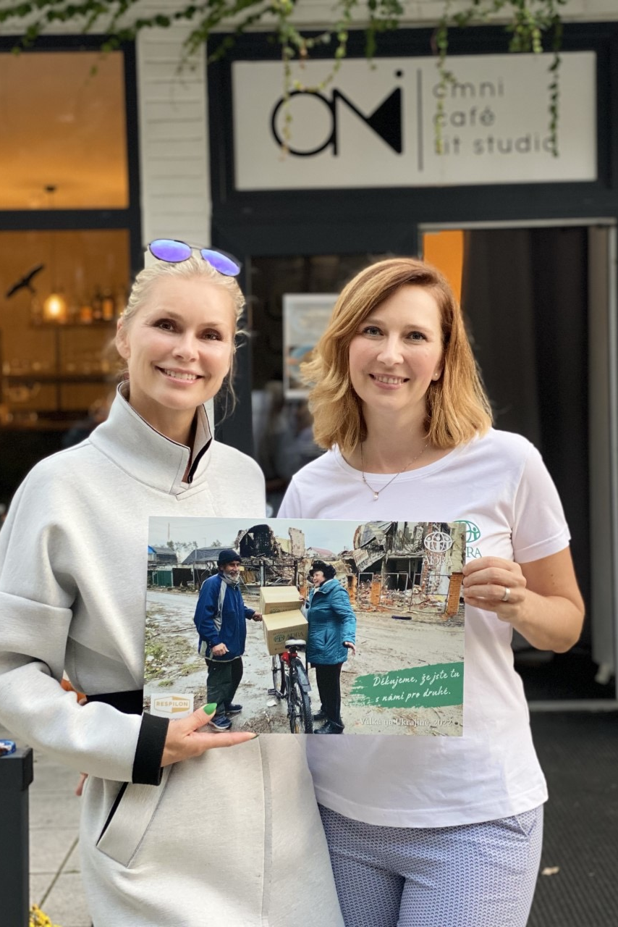
Taking care
Communication - emails, NL
Inform about their help in details
Be in touch - LI, FB
Be grateful

Slide 23
Fundraising is much more than signed donation report
It is an interest.
It is an openness.
It is a connection.
It is a relationship.

Slide 24
What is ahead of us?
why companies are important for cooperation?
do we need a dream list of companies?
first connection
first meeting
taking care of companies
opportunities
vision

Slide 25
Opportunities / ADRA’s buffet table
Company volunteering

Slide 26
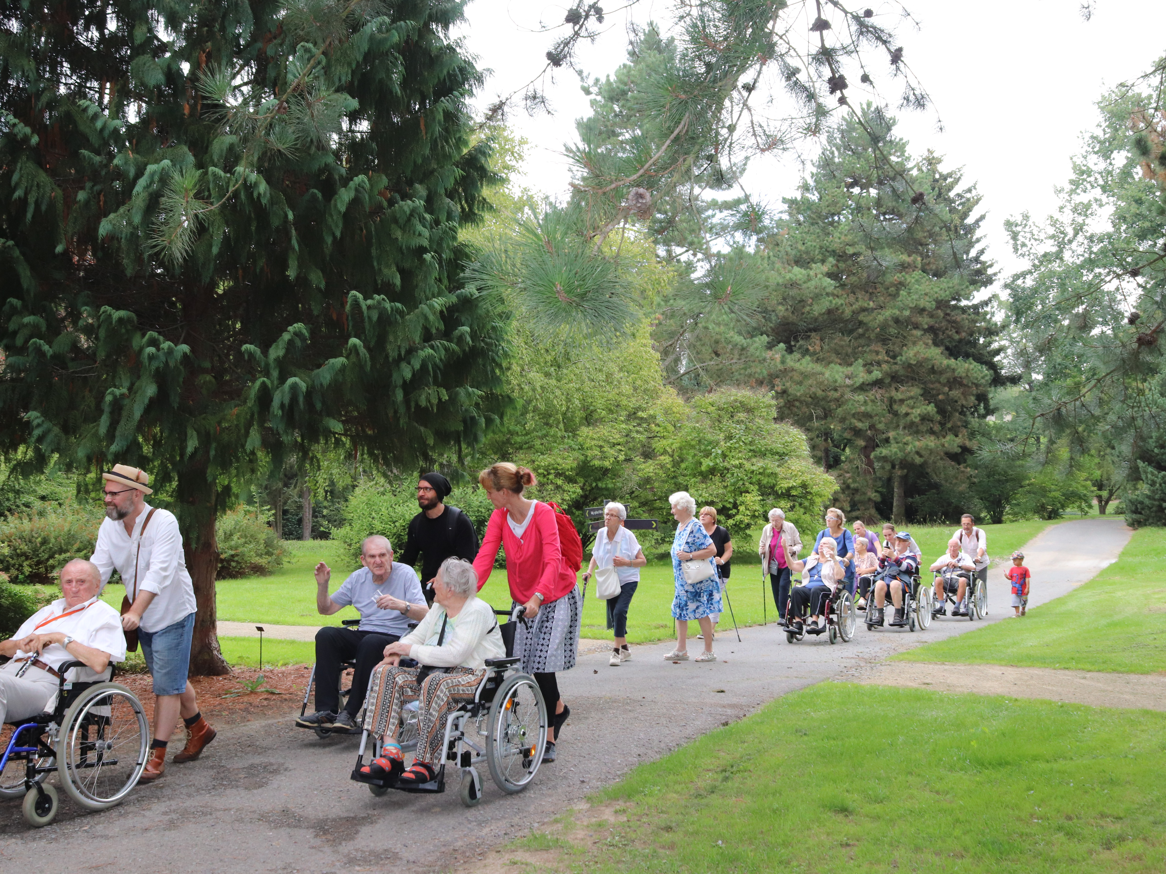

Slide 27
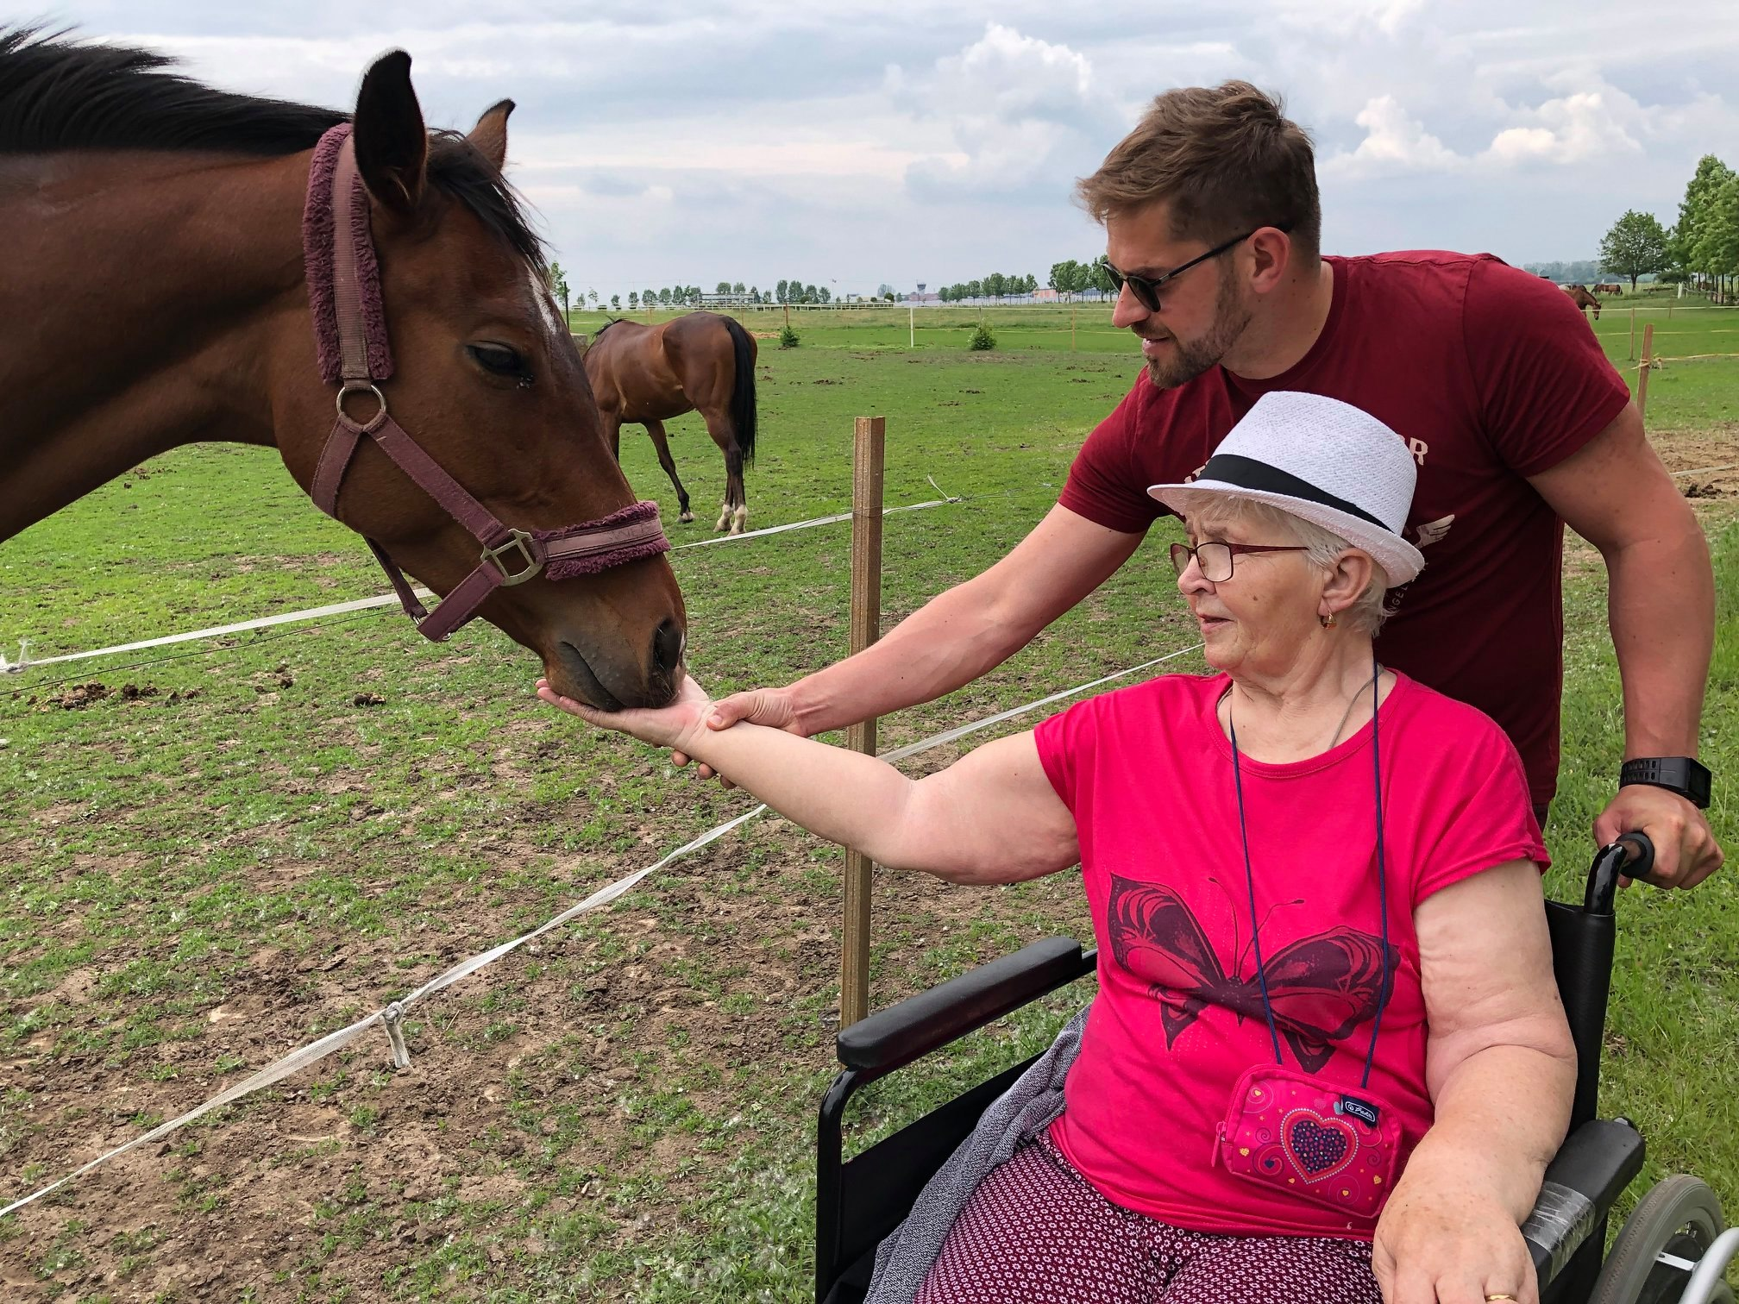

Slide 28
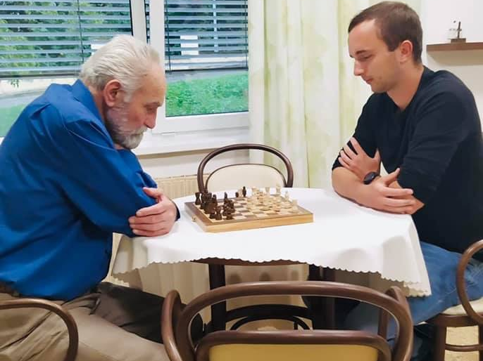

Slide 29
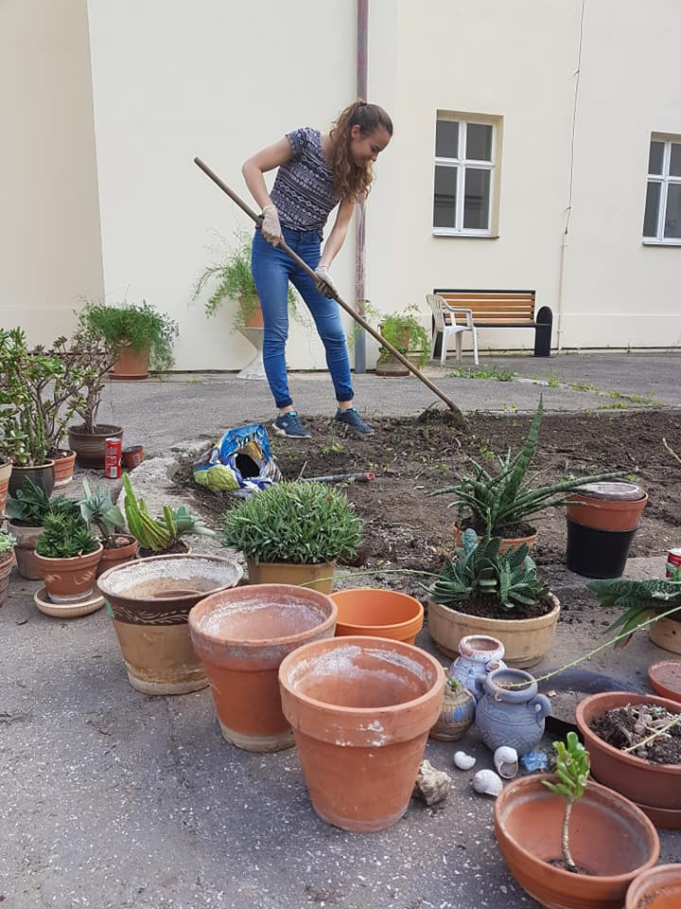
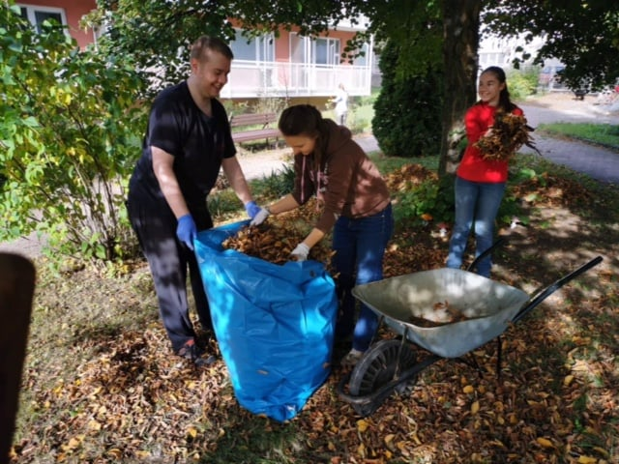
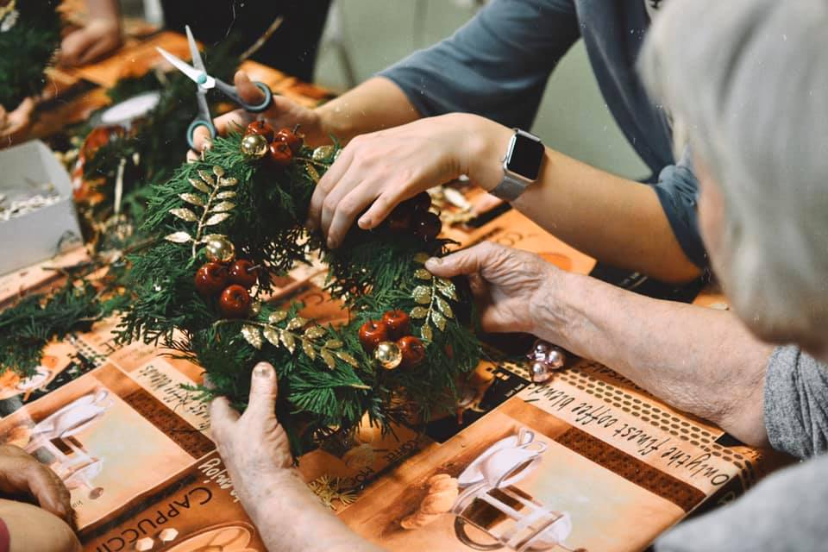

Slide 30
Opportunities / ADRA’s buffet table
Company volunteering
Sports events - ADRA Run

Slide 31
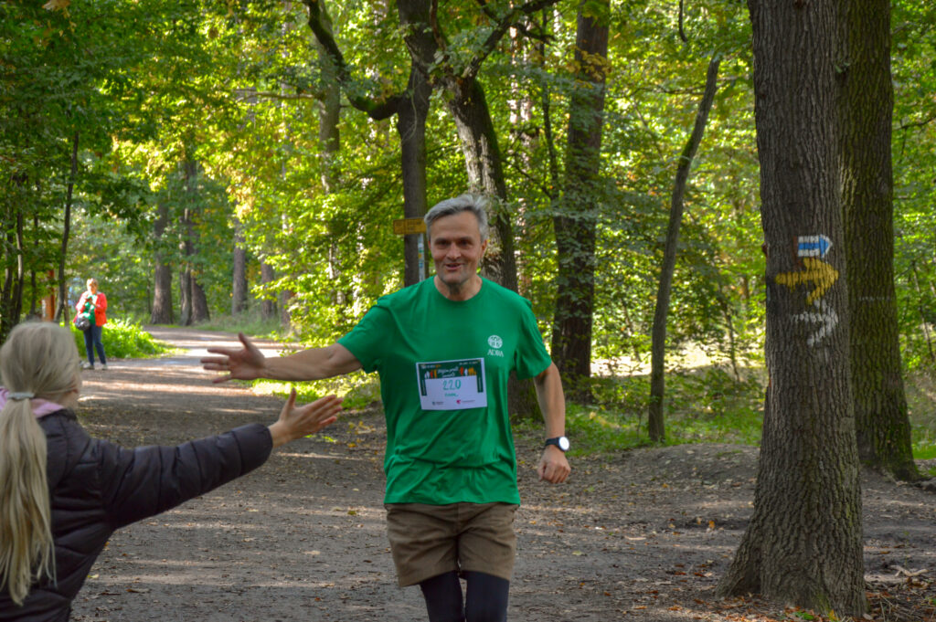
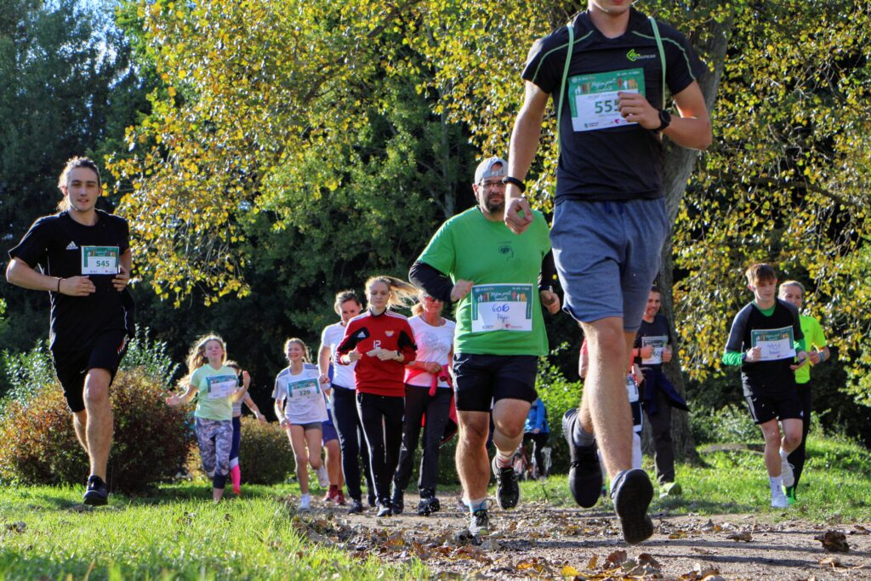

Slide 32
Opportunities / ADRA’s buffet table
Company volunteering
Sports events - ADRA Run
Employees donation
Donation of material help
Cooperation with other NGO

Slide 33
Opportunities / ADRA’s buffet table
Company volunteering
Sports events - ADRA Run
Employees donation
Donation of material help
Cooperation with other NGO

Slide 34
Opportunities / ADRA’s buffet table
Company volunteering
Sports events - ADRA Run
Employees donation
Donation of material help
Cooperation with other NGO

Slide 35
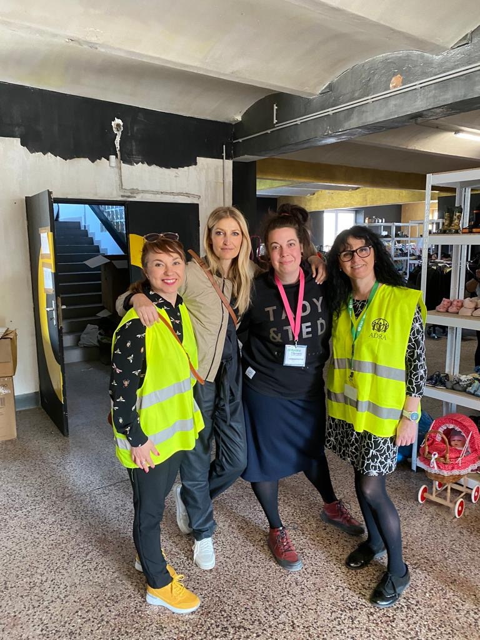
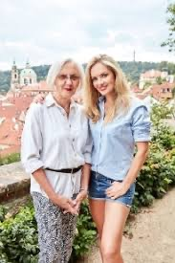

Slide 36
Opportunities / ADRA’s buffet table
Company volunteering
Sports events - ADRA Run
Employees donation
Donation of material help
Cooperation with other NGO
Cooperation with universities - e.g. Newton University
Cooperation with sportsmen and sportswomen, musicians, etc.

Slide 37
Opportunities / ADRA’s buffet table
Company volunteering
Sports events - ADRA Run
Employees donation
Donation of material help
Cooperation with other NGO
Cooperation with universities - e.g. Newton University
Cooperation with sportsmen and sportswomen, musicians, etc.

Slide 38
https://www.youtube.com/watch?v=0JcNSPi9pCg

Slide 39
Opportunities / ADRA’s buffet table
and….
Communication with companies - newsletter, TV screen
Be part of their events - Christmas party, teambuilding
Online webinars - How to help elderly people / How to help during emergencies
“ESG buffet table”

Slide 40
Connection in ADRA Europe
companies want to cooperate in their EU officies
ADRA Slovakia - Geis, Loreal, KIK
Are you interested?

Slide 41
What would like to start with in your ADRA office?

Slide 42
My vision in company FR for 2023
Prepare manual for companies in emergency situation
Do online webinars covering emergency topics
Have 5 new e-shops cooperation
Fulfill fundraising plan for this year
To be happy in my job

Slide 43
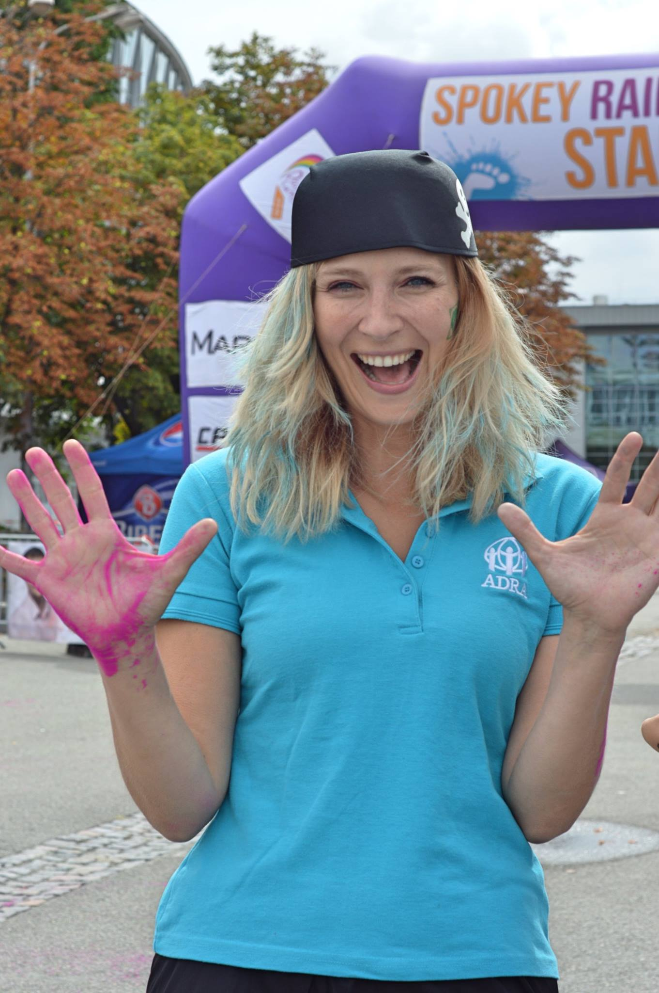
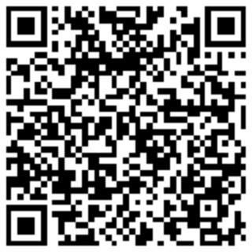
Renáta Benešová Chlebková
ADRA Czech Republic
Renata.chlebkova@adra.cz
Let us be in touch via LinkedIn
https://www.linkedin.com/in/renata-chlebkova/

